Slide 1
Introduction to Nanomaterial and Nanotechnology

Slide 2
Outline
1. What’s nanomaterial?
2. Why do we research nanomaterial?
3.How to research nanomaterial?

Slide 3

“The principles of physics, as far as I can see, do not speak against the possibility of
maneuvering things atom by atom.”
“Put the atoms down where the chemist says, and so you make the substance.”
- Richard Feynman(1959) There's Plenty of Room at the Bottom
1

Slide 4
1. What is nanomaterial?
Nanoscale : generally refers to the size scale of 1 – 100 nm in at least one dimension.
1 nanometer (nm) = 10⁻⁹ m
2

Slide 5
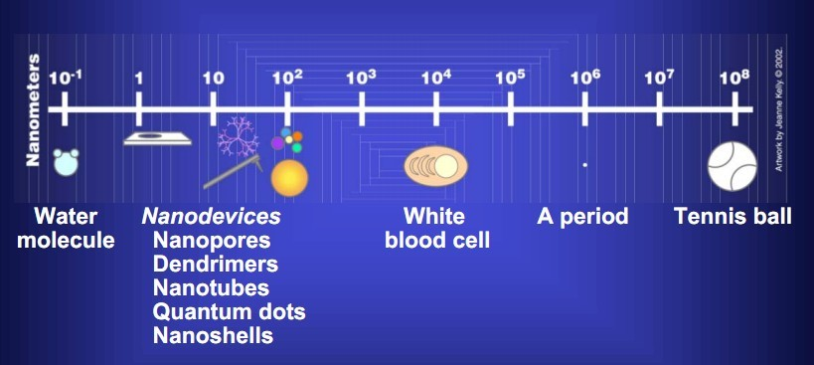

How small is 1 nanometer?
Human hair
3

Slide 6
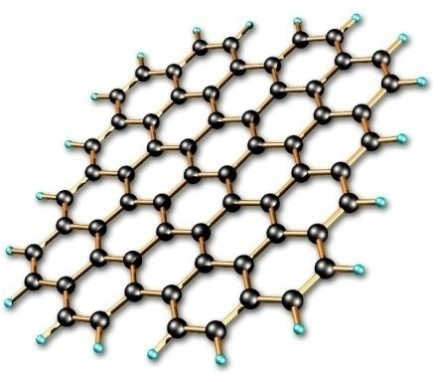
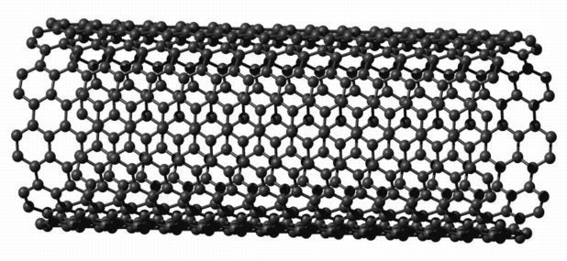
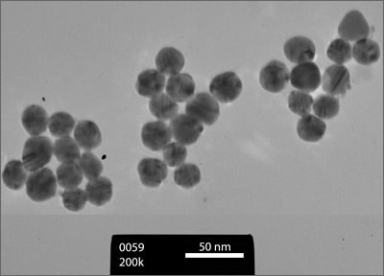
Nanomaterial: refers to the matter whose length scale, in any dimension, is approximately 1 to 100 nanometers.
.
1 D
film
Graphene
2 D
nanowire, nanotube
3 D
nanoparticle
4

Slide 7
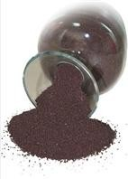
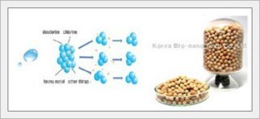
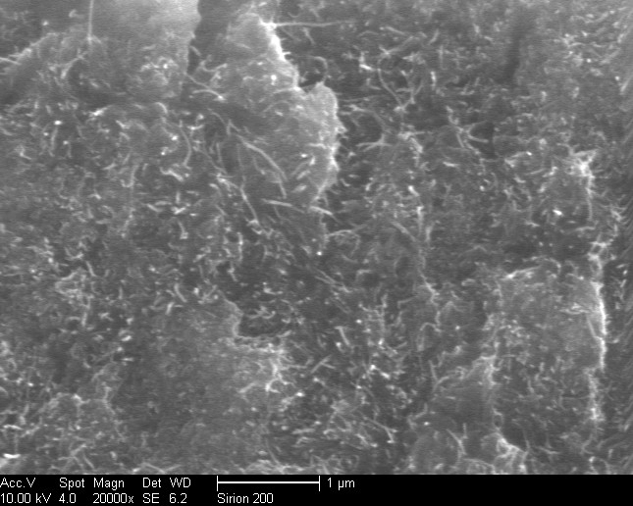
Nanomaterials can be metals, ceramics, polymeric materials, or composite materials.
5

Slide 8
2. Novel properties
What has happened when reduced to the nanoscale?
Small size effect (Quantum size effect)
Quantum Mechanics
--Contain very small number of atoms(molecules)
--Electromagnetic forces are dominant.
--Wave particle duality. The electrons exhibit wave behavior.
--Quantum confinement.
--Discrete energy levels
6

Slide 9
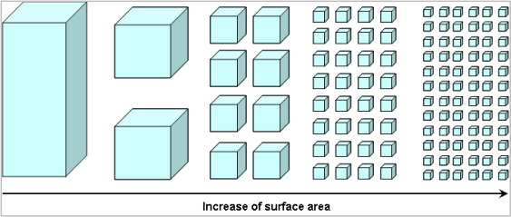
Large surface effect:
--The vastly increased ratio of surface area to volume.
The total volume remains the same, the collective surface area is greatly increased.
Catalysis properties
7

Slide 10
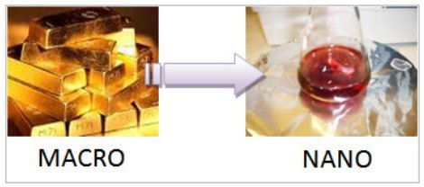
2.2 Novel property
A piece of gold is golden in color.
A colloid of gold nanoparticles is ruby red in color.
8

Slide 11
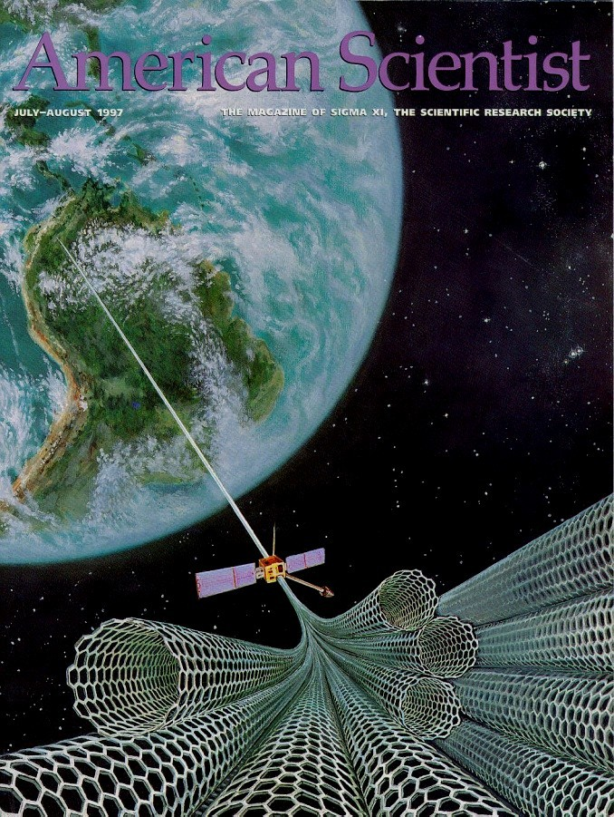
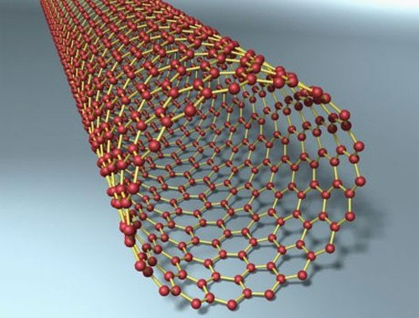
200 times stronger than steel of the same diameter.
Space elevator its principle is through a 100,000km long super-human strength of the cable into space, one end of the cable located on the earth, one end located on satellite.
9

Slide 12
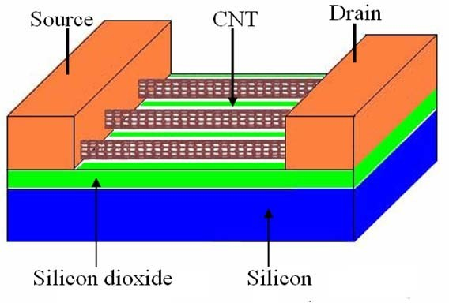
Nano-electronics
Moore’s law
If the number of chips keeps on increasing, more heat, excessive leakage current.
nanomaterial electronics, molecular electronics.
Excellent conductors of electricity and heat much smaller, lower power consumption, faster calculation.

Slide 13
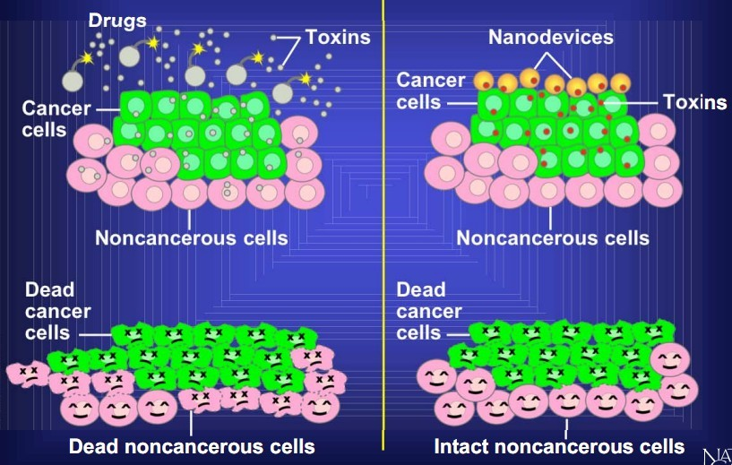
Nano-medicine
Nanomedicine can detect the cancer cells and deliver the toxin in
a controlled, time-released manner.

Slide 14
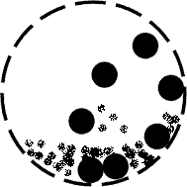
3. How to research nanomaterial?
3.1 Preparation
Top-down
(Physical method)
Mechanical attrition: Break the particles into nanostructures
High energy mill,

Slide 15
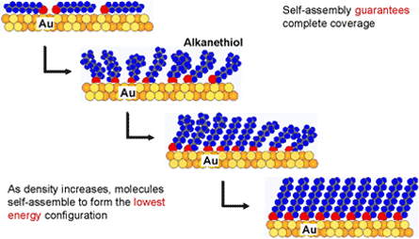
bottom-up (chemical method)
Chemical Vapor Deposition (CVD)
Self Assembly
Directed by Van der Waals force
Hydrogen bonding….

Slide 16
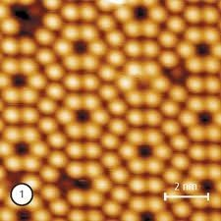
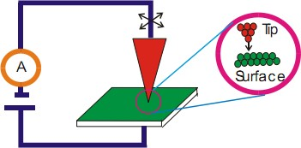
3.2 Characterization
(1).Scanning Tunneling Microscope(STM)
Works by sensing the tunneling current between the sharp tip and the conducting surface when the tip is brought close to the surface.
silicon

Slide 17
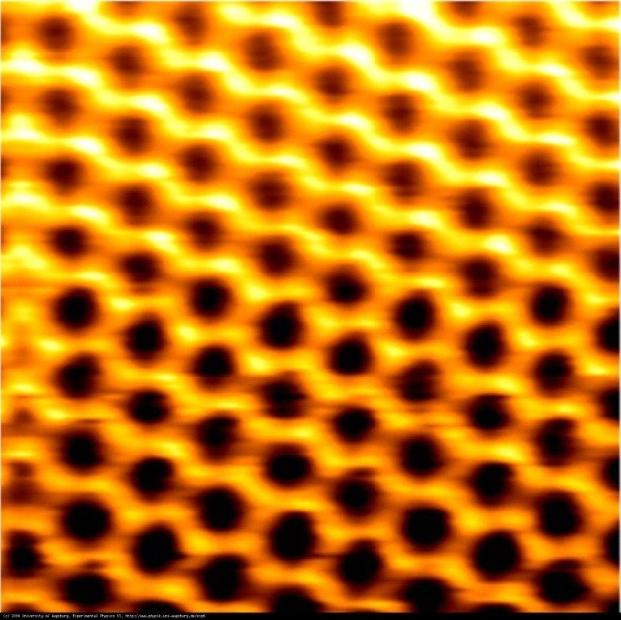
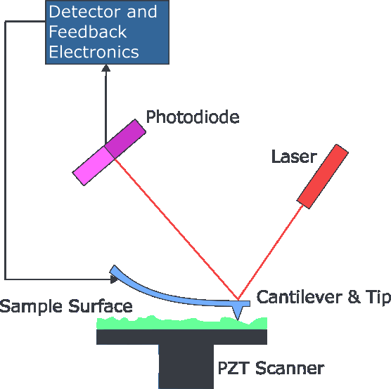
(2). Atomic Force Microscope
Measure the Van der Waals Force
tungsten

Slide 18
references
Applied nanotechnology. Jeremy Ramsden
http://en.wikipedia.org/wiki/Nanomaterials
http://en.wikipedia.org/wiki/Atomic_force_microscopy
http://en.wikipedia.org/wiki/Nanoelectronics
Processing and synthesis techniques for the preparation of nanomaterials

Slide 19


